Slide 1
STAT 515 Final Project - Team 8
The State of Mind: Evaluating Depression Trends in California
Presented By,
Venkata Naresh Kumar Singavarapu
Manasa Rajagopal Madabushi
Vani Subadhra Yelleti
Akshaya Arigela

Slide 2
THE DATA USED FOR THIS PROJECT:
The source of the data:
California Department of Public Health. (2024, March 30). Adult Depression (LGHC Indicator). Retrieved from Let's Get Healthy California: https://letsgethealthy.ca.gov/goals/living-well/mental-health-and-well-being-reducing-adult-depression/
About the data:
This dataset represents the Adult Depression (LGHC Indicator) and shows the proportion of adults in California who were ever told they had a depressive disorder. Data was sourced from the California Behavioral Risk Factor Surveillance Survey (BRFSS) and collected by the Public Health Survey Research Program at California State University, Sacramento under contract with the CDPH. This indicator is drawn from the question about being informed by a health professional of having a depressive disorder, which includes conditions such as depression, major depression, dysthymia, or minor depression. Note that the data for the denominator and weighting come from the California Department of Finance, and therefore may differ from those published in national BRFSS data tables by the CDC or other federal agencies.
The dataset adult-depression-lghc-indicator-24.csv consists of 161 observations and 8 variables.

Slide 3
GOALS OF THIS PROJECT :
The goal is to evaluate the trends and factors associated with depression in the adult population of California.
Questions to be answered in this project:
What is the prevalence of reported depressive disorders among adults in California over the selected timeframe?
Which demographic variables (e.g., age, gender, income) are significantly associated with the incidence of depressive disorders?
How do depression rates vary across different regions within California?
Can we predict the likelihood of depressive disorder reports based on available demographic and regional data?

Slide 4
GOALS OF THIS PROJECT :
Methods used to explore the data in this project are:
Descriptive Analysis to summarize the main characteristics of the data and provide a clear picture of the population’s mental health status.
Regression Analysis to explore the relationships between demographic variables and depression rates.
Principal Component Analysis enabled us to reduce the complexity of our dataset, focusing on the most significant variables influencing depression trends in California.
Hierarchical clustering using single, complete, and average linkage methods allowed us to identify and visualize distinct groups within the data, uncovering hidden patterns in depression rates across different demographics and regions of California.

Slide 5
EXPLANATION OF THE DATASET WITH VARIABLES
The dataset titled `adult-depression-lghc-indicator-24.csv` likely includes variables that measure the prevalence and characteristics of depression among adults, structured for in-depth statistical analysis.
Key variables might encompass demographic details (age, sex, ethnicity), socioeconomic status (income, education), and health indicators (depression percentages), facilitating a nuanced exploration of factors influencing mental health outcomes.

Slide 6
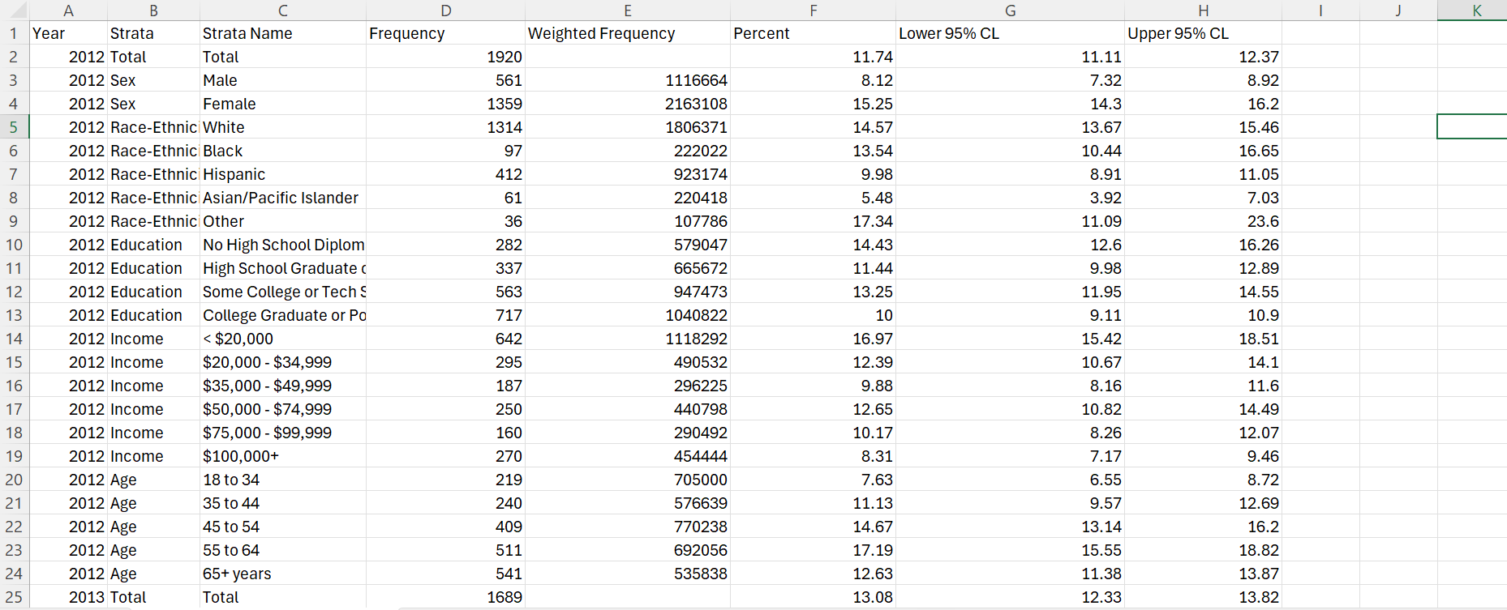
DATASET

Slide 7
DATASET
TABLE HEADER(COLUMN NAMES) | DATATYPE
Year | Interval
Strata | Nominal
Strata Name | Nominal
Frequency | Ratio
Weighted Frequency | Ratio
Percent | Ratio
Lower 95% CL | Ratio
Upper 95% CL | Ratio

Slide 8
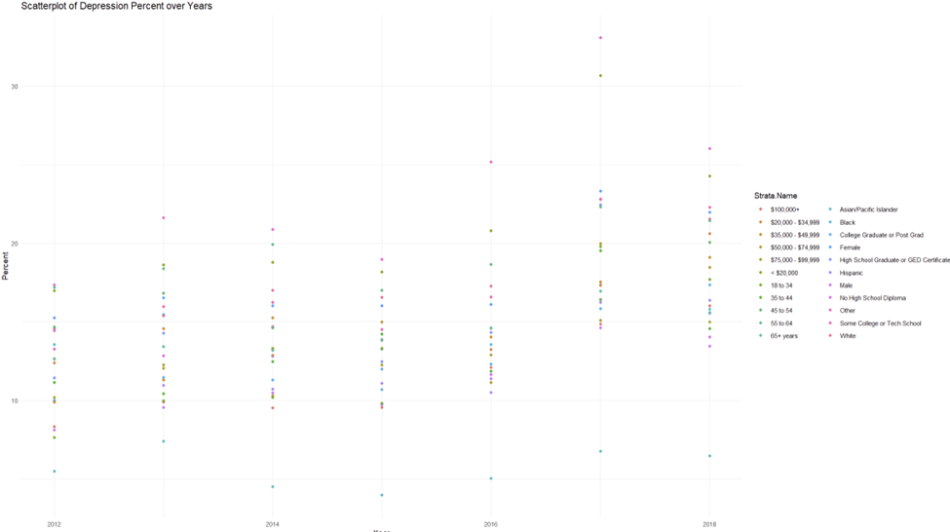
SCATTERPLOT OF DEPRESSION OVER YEARS

Slide 9
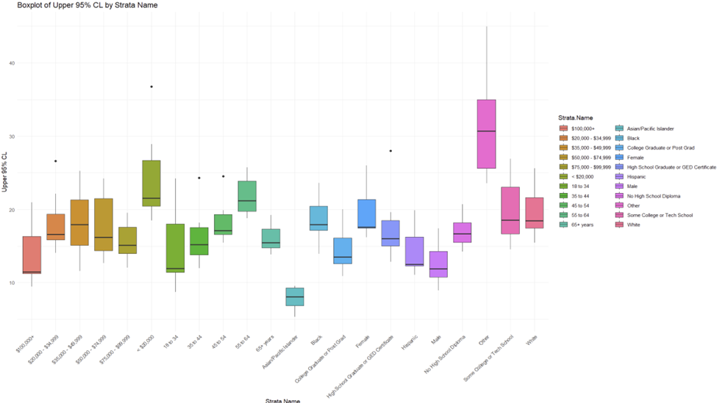
BOXPLOT OF UPPER 95% CL by Strata Name

Slide 10
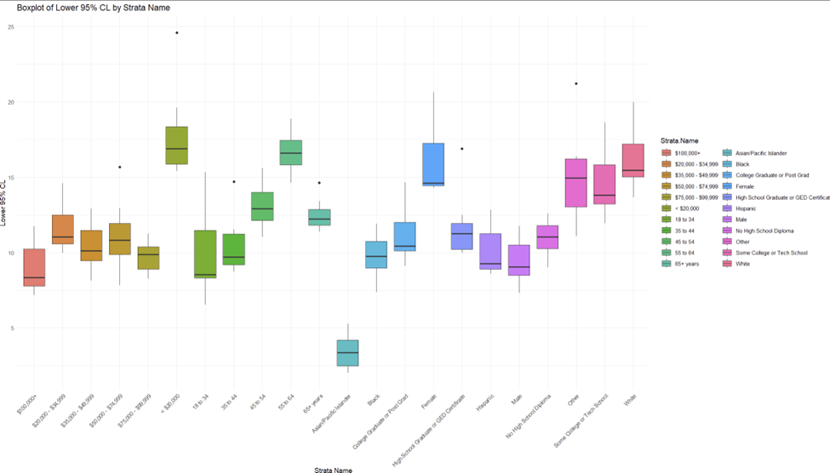
BOXPLOT OF LOWER 95% CL by Strata Name

Slide 11
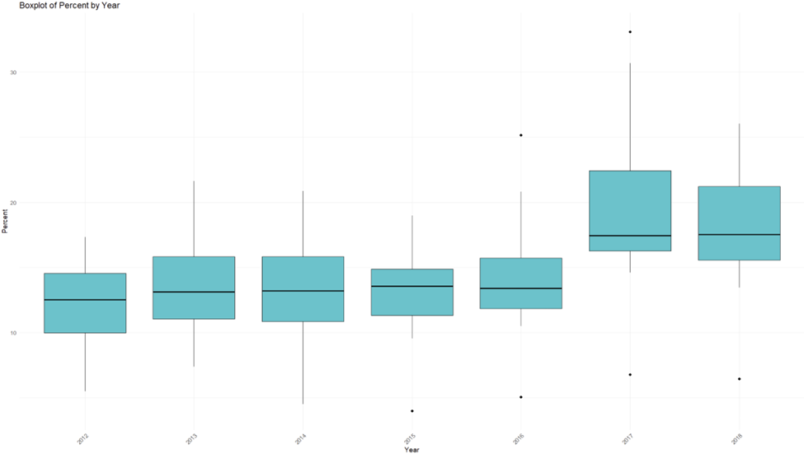
BOXPLOT OF PERCENT BY YEAR

Slide 12
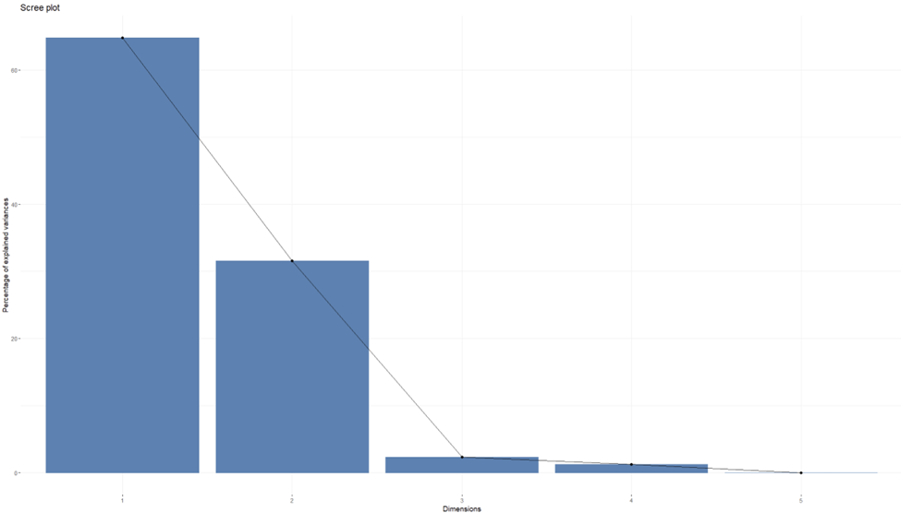
Scree plots showing how much variation each principal component captures from the data

Slide 13
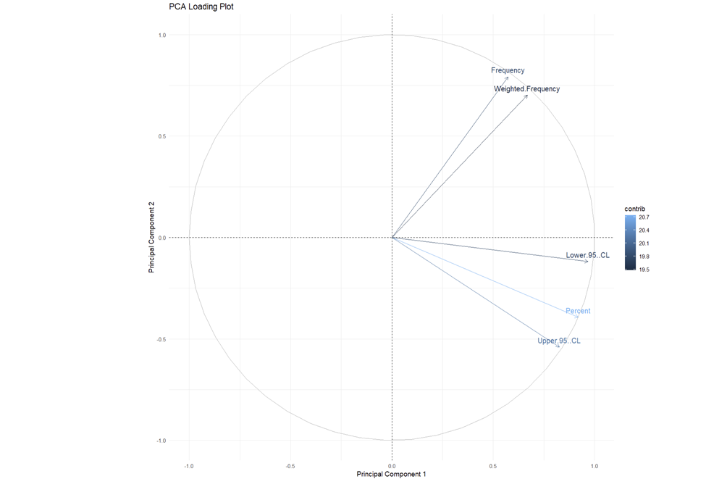
Loading plots showing how each characteristic influences principal components (PCA)

Slide 14
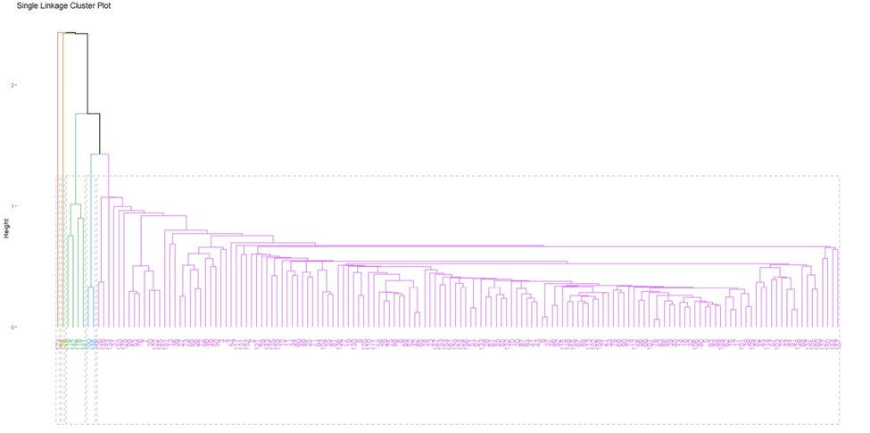
SINGLE LINKAGE CLUSTER PLOT

Slide 15
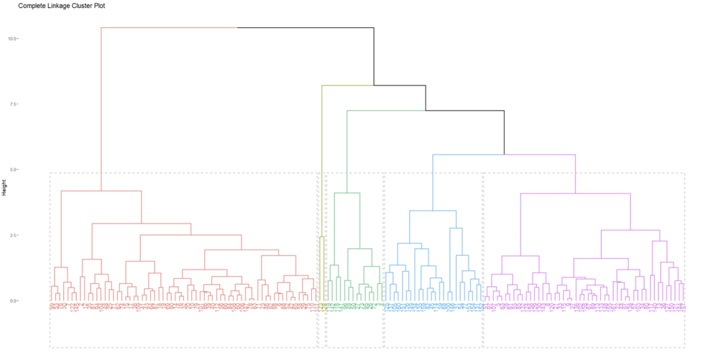
COMPLETE LINKAGE CLUSTER PLOT

Slide 16
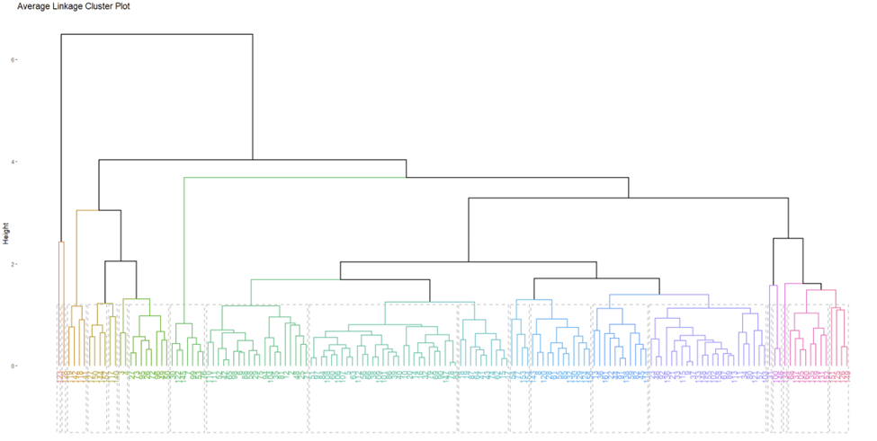
AVERAGE LINKAGE CLUSTER PLOT

Slide 17
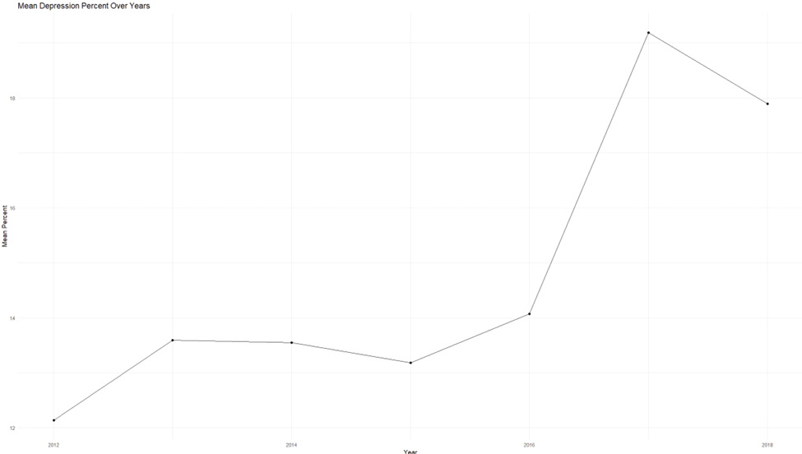
MEAN DEPRESSION PERCENT OVER YEARS

Slide 18
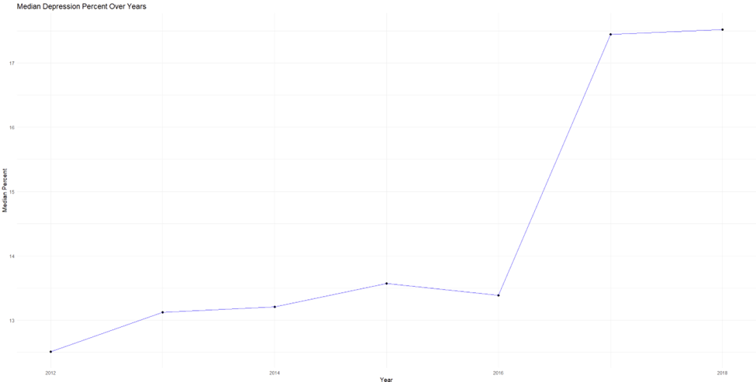
MEDIAN DEPRESSION PERCENT OVER YEARS

Slide 19
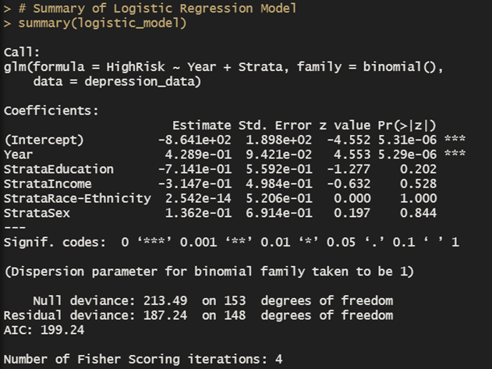
MODEL ANALYSIS(REGRESSION MODEL)
Targeted mental health interventions may be needed for certain demographic groups.
Continuous monitoring of depression trends is essential to evaluate the effectiveness of public health policies.
Predict the prevalence of depressive disorders among adults in California.

Slide 20
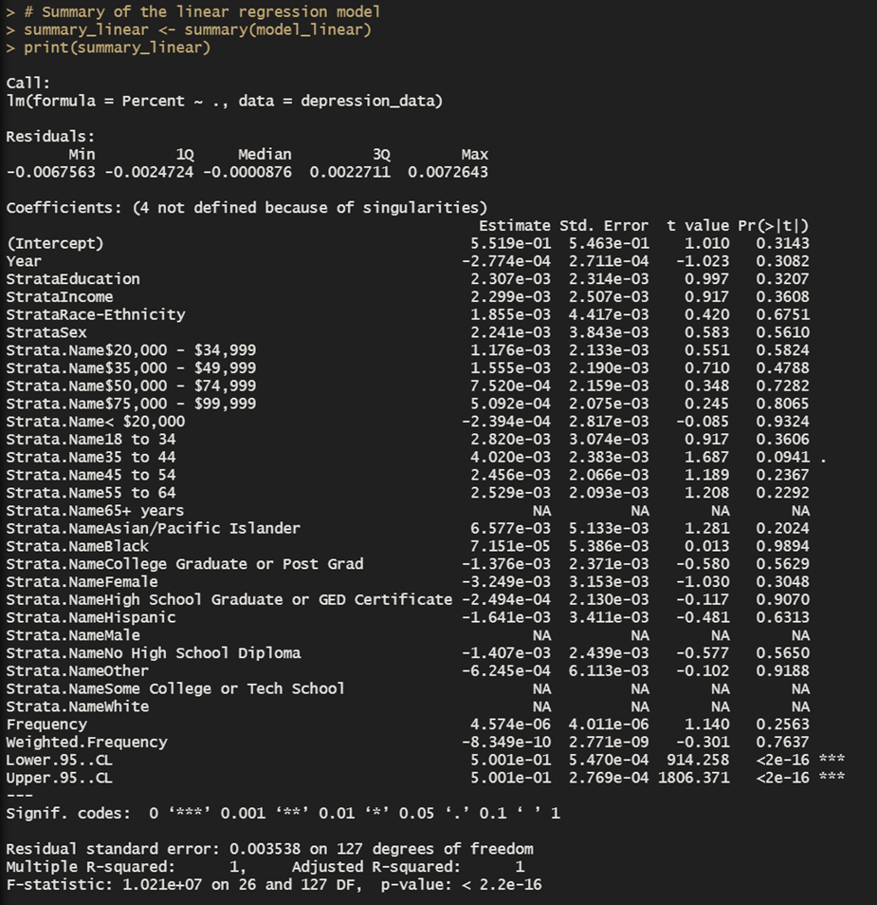
LINEAR REGRESSION
Linear regression is a statistical method
used to model the relationship between a
dependent variable and one or more independent
variables.

Slide 21
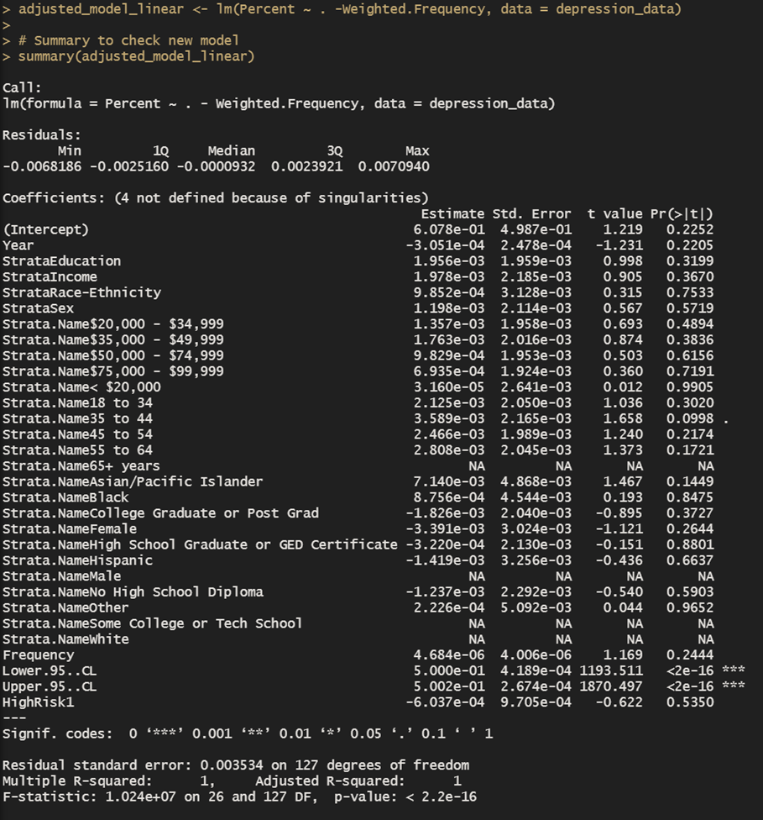
ADJUSTED MODEL LINEAR
An "adjusted model" in linear regression is a refined version of the statistical model that controls for various variables to provide a more precise analysis of the data.

Slide 22
LASSO MODEL
To mitigate multicollinearity, we consolidated variables such as occupation titles with region types, which streamlined the feature set for more effective lasso regression application.
Lasso regression tackles multicollinearity by applying a penalty that compresses the size of coefficients corresponding to collinear predictors, thus enhancing model reliability.
Utilizing K-Fold cross-validation helps pinpoint the most suitable penalty strength to optimize model performance by reducing the Mean Squared Error (MSE).

Slide 23
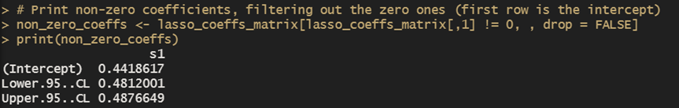
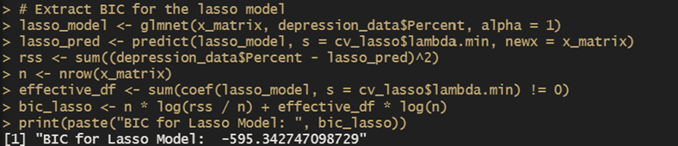

LASSO MODEL

Slide 24

AVERAGE ANALYSIS
Average Analysis refers to the process of calculating the mean performance metric (such as accuracy) across all folds of cross-validation.

Slide 25
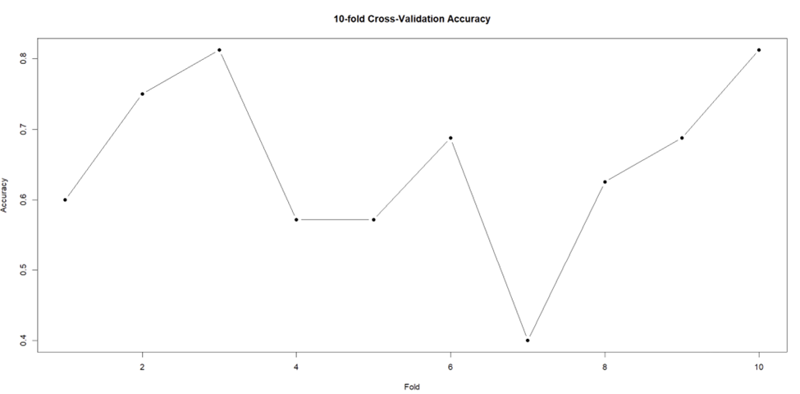
10-FOLD CROSS VALIDATION

Slide 26
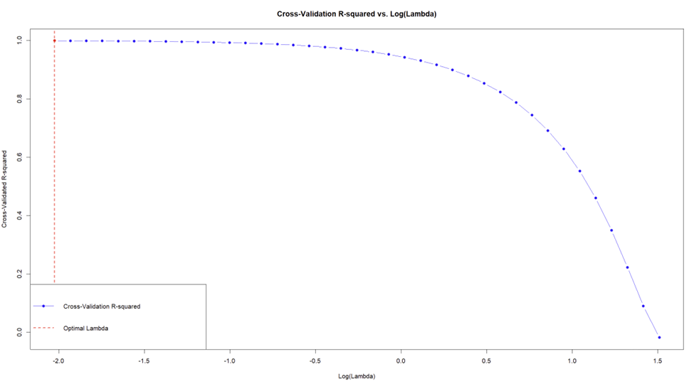
CROSS VALIDATION R-Squared vs Log(Lambda)

Slide 27
FUTURE WORK
Employ Bayesian hierarchical models to analyze the variability in depression rates across different demographics and regions. This method allows for incorporating prior knowledge and uncertainty in estimates, which is particularly useful in complex datasets where parameters vary significantly across groups.
Enhancing the lasso regression approach by normalizing the dataset could refine feature selection and coefficient reduction, thereby improving model precision.
A detailed residual examination is advised to identify and correct any discrepancies within the model, which entails analyzing residual distribution and pinpointing outliers or influential data points.
Implementing a Bayesian approach to logistic regression may yield a more nuanced understanding of model parameters and predictions, allowing for probabilistic and more accessible interpretations.

Slide 28
THANK YOU

